Slide 1

Logistics Knowledge Graph
Dena, Cornelis, Maaike

Slide 2
Outline
Why a formal model
Logistics Knowledge Graph
Examples for “Whys”
Architecture Components
Roadmap and Milestones
Open questions

Slide 3
Why a Formal model
Interoperability support
Create a shared understanding of Logistics domain
Data, standards, protocol Integration
Consistency checking
Automatic Inference and knowledge discovery
Forward Compatibility

Slide 4
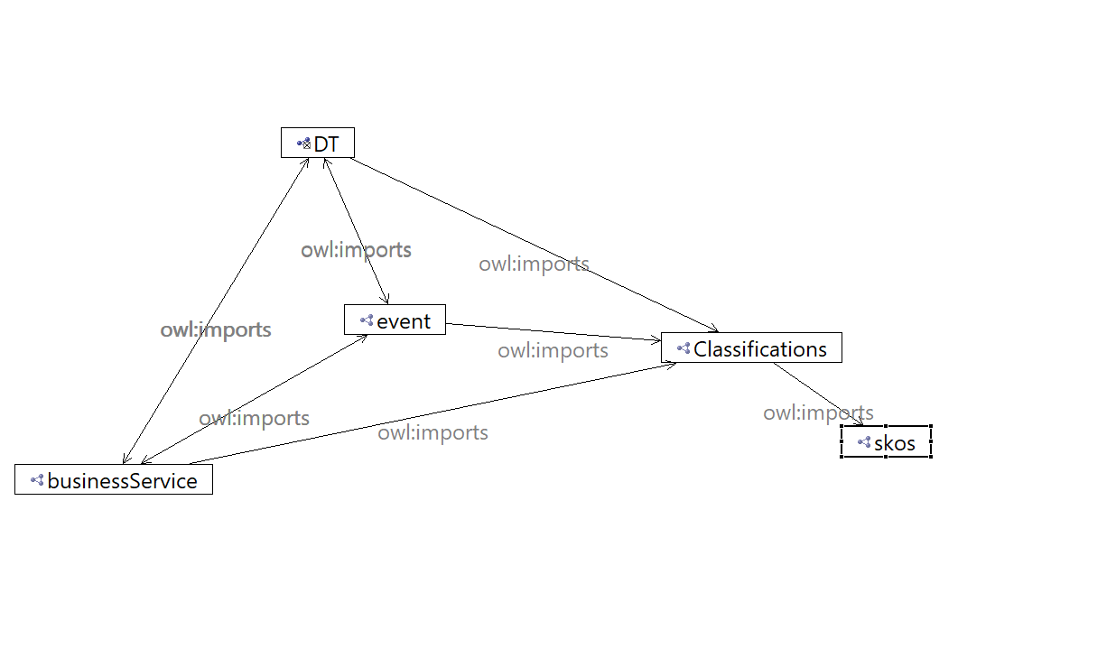
Logistics Knowledge Graph
Logistic Digital Twins
Logistic Event
Logistic Business
Classifications (to do)
Governance (to do)
Shape Graphs

Slide 5
Digital Twins
Any real-world physical object
Attributes
It can be defined per type and subtype

Slide 6
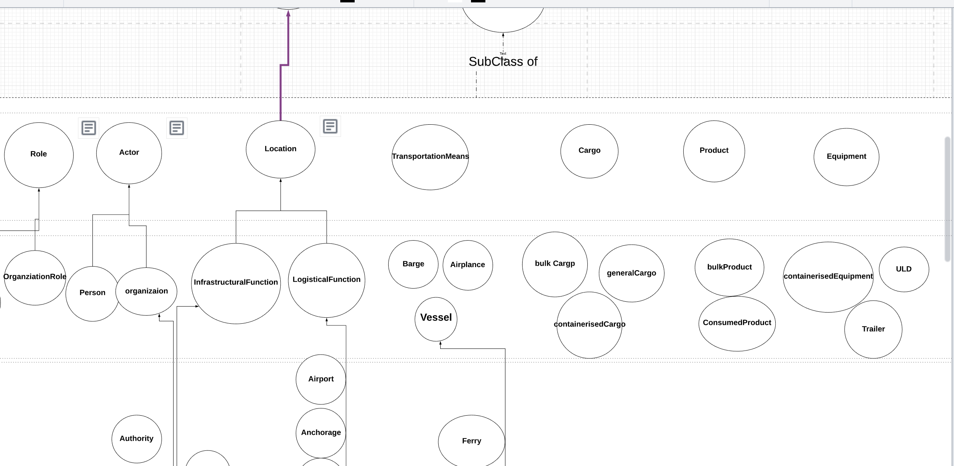
https://app.lucidchart.com/invitations/accept/c45b2933-815d-40a5-83cf-3709cdae3bde

Slide 7
Event
Represents actions, milestones, transactions or any other real-world activity. These will typically involve one or more interactions or associations between location, business service, transport means and cargo.
Attributes
Date
Time
Milestone

Slide 8
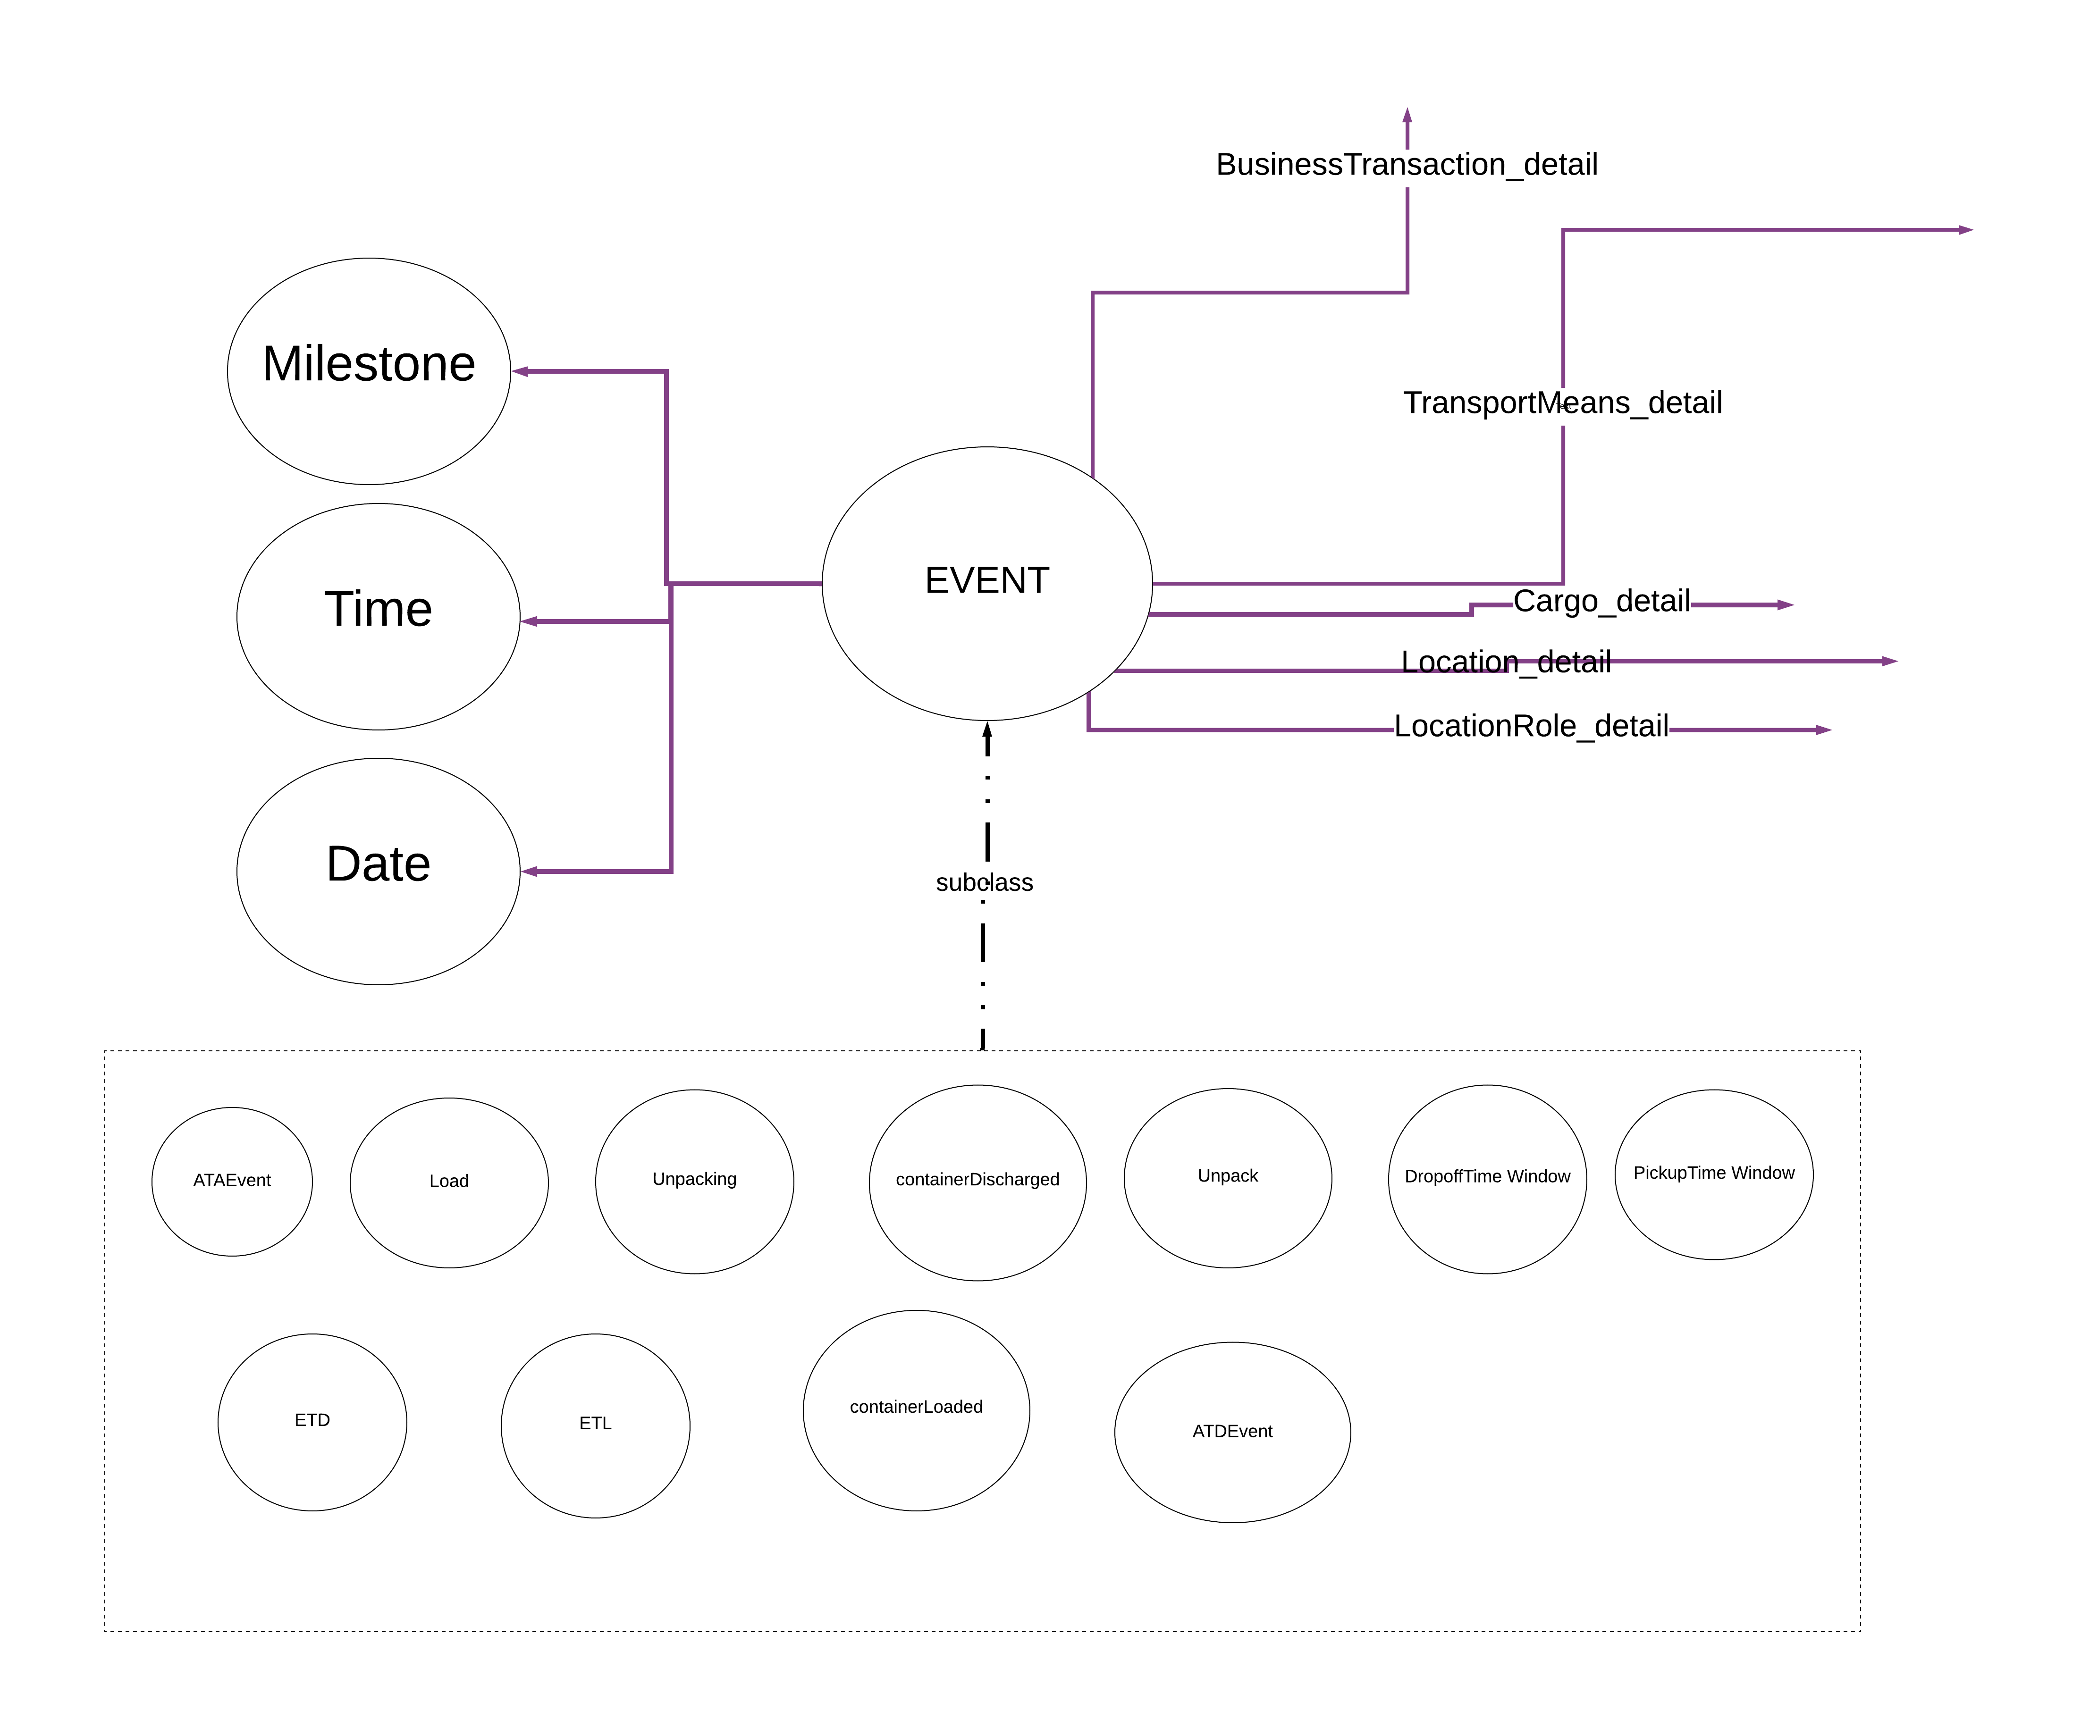

Slide 9
LogisticBusiness
Logistic Service
It is defined by the actor involved,
The transport means invovled,
Its result in logistic trasnaction,
Delivery code
Payment method code (code)
Logistic Transaction
Transaction ID
Transaction Date
has associations with the Event

Slide 10
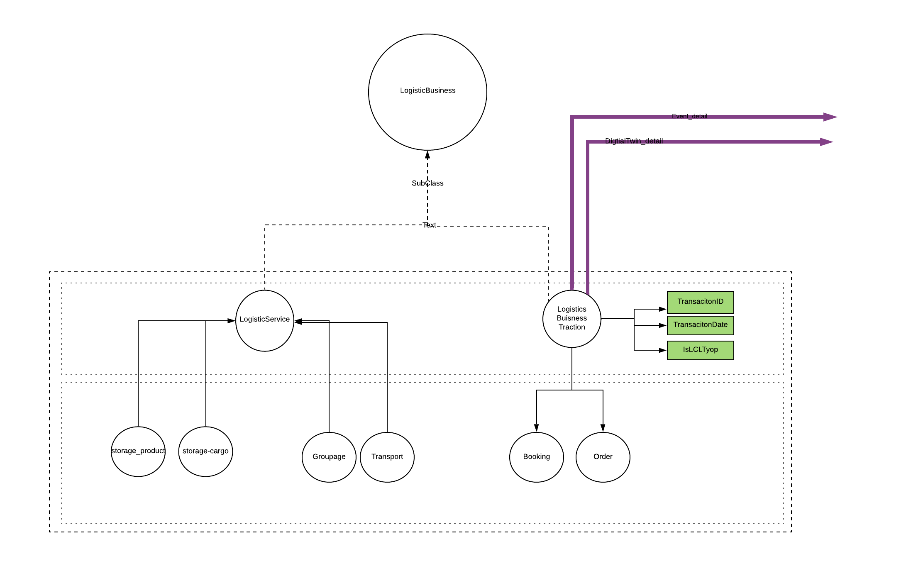

Slide 11
https://app.lucidchart.com/invitations/accept/636635f6-7388-4e3a-bc38-77dedeb06d96

Slide 12
Classification
Dangerous Goods,
Hazard code,
…

Slide 13
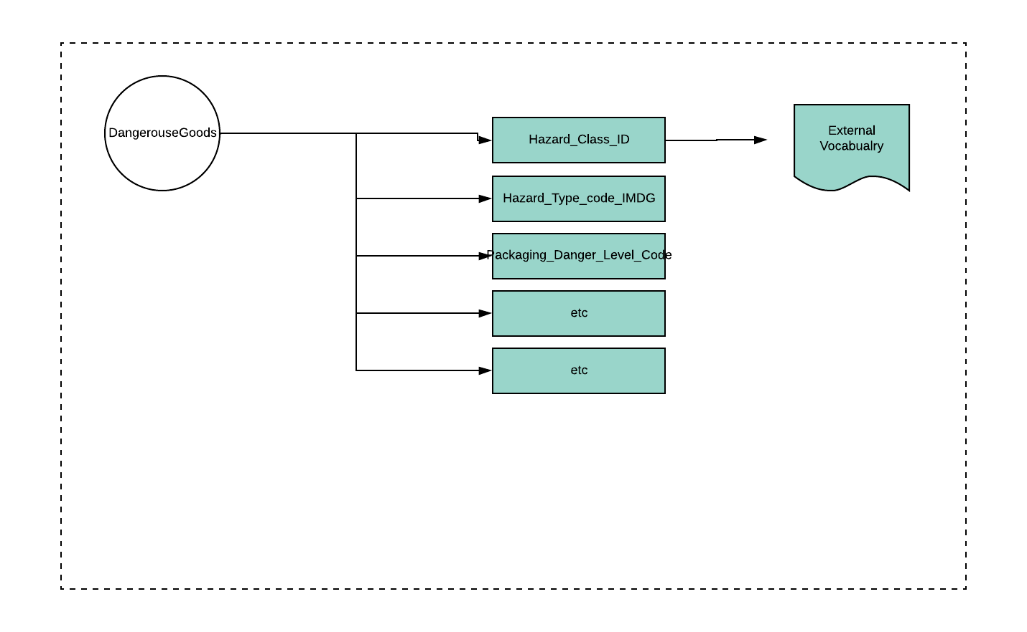

Slide 14
Shape Graphs -- shacl
A shape graph that uses the core model (a rdf file) an enable us to define:
DataTypes constraints
String constraints
Property Constraints
Data Format
Rules,

Slide 15
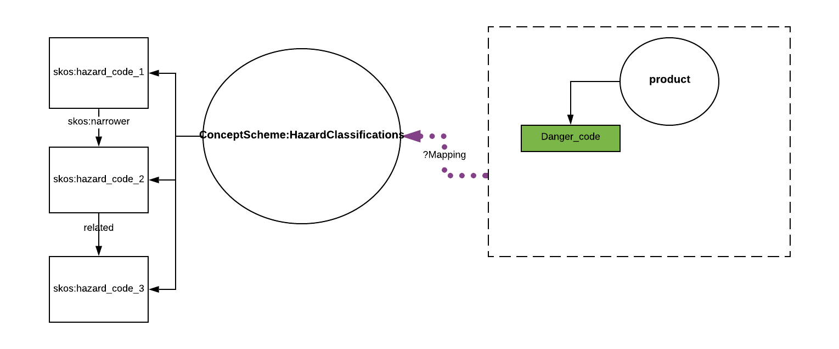
Interoperability

Slide 16
Create a shared understanding
Reference lexcion
unambiguous terminology
unambiguous defintions
Involves synonym and variations in languages

Slide 17
AConsistency Checking
Value range restriction specification on a per-class basis,
Validation and verification testing on the data set
Constraints rules
Data
Product_1 a :Product ; dt:productName “TG2” . #Fails dt:Hs_code “P567“ . product_2 dt:productName “TGSH” . dt:HS_code “P567“ . #passes
:Product sh:property [ :path dt:productName ; :minLength 4 ; :datatype xsd:string ; ] ; and sh:property [ sh:path dt:HS_code ; sh:pattern “p\\d{3,4}” ; ] , Sh:message a sevirity:error "Min Length for product name is 4"
Validation report:
Error for product_1 ,
MESSAGE: "Min digital Length for product nam must be
4 characters"

Slide 18
Allow for Inferencing
subClass inference
A bus driver is a person that drives a bus,
a bus is a vehicle.
A bus driver drives a vehicle, so must be a driver.
If the milestone is start, and
If the date and time is actual, and
If we know transportmeans (ships) exists in Location (port), that has Geopraphic ID (x),
Then the incoming Event is of type ATA (Actual time of arrival).
Notes:
https://app.lucidchart.com/documents/edit/3895fbc0-a4b6-4e7e-b8d6-1976c6963d67/VUwf3zkNfOrv

Slide 19


Project Milestones and roadmap
Usecase development
Modeling based on usecase
Mapping to existing standards
Integration with other components

Slide 20
Identified Components for the architecture
Logistic Knowledge Graph (Storage)
Incoming Data (data repository)
Mapping module
Pipeline for Transformation, Validation, identification, deduplication components
Storage (semantic Ledgers)
Validation and inference Rules engine
Query service
API(s)
Services and Applications

Slide 21
Open Questions
What is a typical scenario and which queries are involved in the backend?
How does the semantic ledger store the data stream?
In which component does the reasoning and consistency checkings occur?

Slide 22

Thank you for
Your time

Slide 23
End OF THE PRESENTATION

Slide 24
Unified process for ontology building De Nicola, Missikof, Navgili (2005)
Based on Unified process (UP) methdology in software development and UML space,
Use-case driven, more suitable for application ontologies than for domain ontologies,
Goals
reduction of time and cost in the development of large scale ontologies,
Quality improvment of the developed ontology via progressive validation of intermidiate result.
Methodology for efficient collabroation of Knowledge engineers and domain experts with clear separation of roles.

Slide 25
Cycles- phases – workflows - protoype
Development is divided into cycles, which are subdivived into 4 phases of iterations (inception, elaboration, construction, transition).
Each iteration consists of 5 workflows:
Requirement
Analysis,
Design,
Implementation, and
Test,

Slide 26
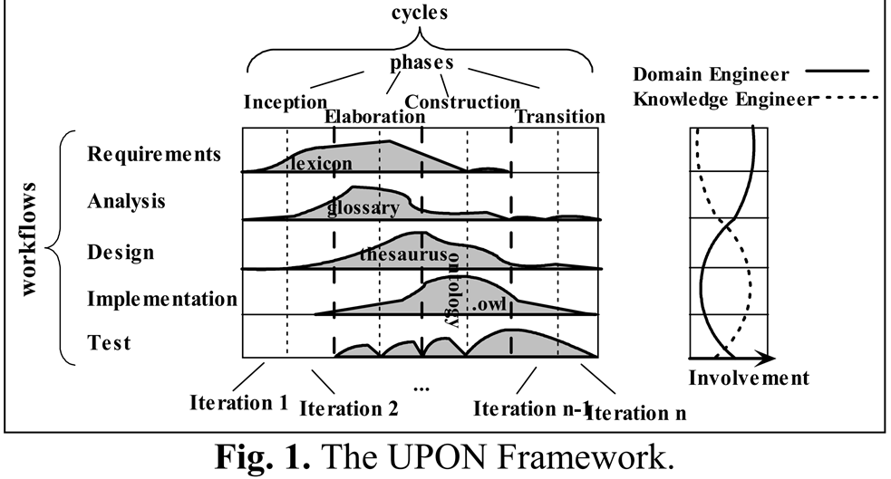

Slide 27
Requirement workflow
Input:
Interviews with the domain experts,
application specific documents,
standards, reference models (reuse, or integration)
Output:
Use-cases
userstories
Goal
Scope, out of scope
Event and activity diagrams
Actors, interfaces involved,
Non functional requirements,
Competency question

Slide 28
Competency Question
Questions the knowledge base, application or ontology should be able to answer in fulfillment of the use case and a representation set of sample answers.
DerivedFrom:
Userstories,
Flow diagrams
Actor diagram,

Slide 29
An example
From the garden-oriented user story interested in oak-root fungus susceptible trees:
Question
? From the set of approved trees for the city of Newyork, identify all those that are oak root fungus resistant, that flower, that are deciduous, and whose leaves turn colors in the fall.
Answer:
>> Koelreuteria paniculata (golden rain tree), melaleuca stypheloides (prickly paperbark), lagerstroemia indicus (crepe myrtle), malus ” Robinson” and ….
MoreAnswers:
>> Definitely not a cinnamomum camphora (camphone tree_

Slide 30
The answers entail:
Onboard the list of trees, (what data)
analyse to see which of the trees on the list are oak-root fungus resistant (needs some sort of confirmatin from authories or garden sites),
which are deciduous ( there might be a classificaitons ),
which are flowering (may require a separate reference),
which showy fall foliage (reference),
spatial indicators of geographic location, (newyork)
rules or regulations,
Not be cinnamum (restrictions on types)
Defintions of each types

Slide 31
Considerations in answering the CQ
considerations for encoding the information,
checking values and, threshold of property values .
Data elements
Types and definitions,
Inference might be needed, (constrainsts)

Slide 32
(2) Analysis workflow
Input
Existing external sources (standards, documents, ontologies,)
Application Lexicons
Analysis of the competency answers and questions,
Output
Domain lexicon,
Reference model,
Identifying the architectural modules
Reference glossary standard --reference for all the terms in the ontology

Slide 33
(3) Design Workflow
Input
Reference glossary,
Type diagrams (UML diagram),
We know architectural components
Output
Ontology (semantic network) – not yet formal -- Diagrams
Identified (constructs – hierarchies, specific relations),

Slide 34
(4) Implementation workflow
Input:
Semantic network / ontology
Output
Owl or other owl dialects
Presentation patterns, naming conventions,
Logical patterns
Representing validation and inference rules

Slide 35
(5) Test
Input
formal ontology,
Example instantitions (Abox)
Output
Tested owl ontology ( in pilotes)
Verify the coverage (measure)
Answering comeptency question
Here we find the gap and then iteration starts again

